Slide 1
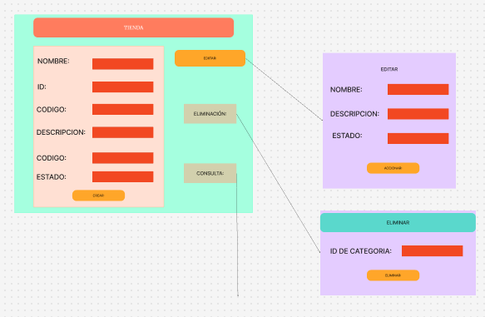
Víctor Manuel Brand Cepeda

Slide 2
Víctor Manuel Brand Cepeda

Slide 3
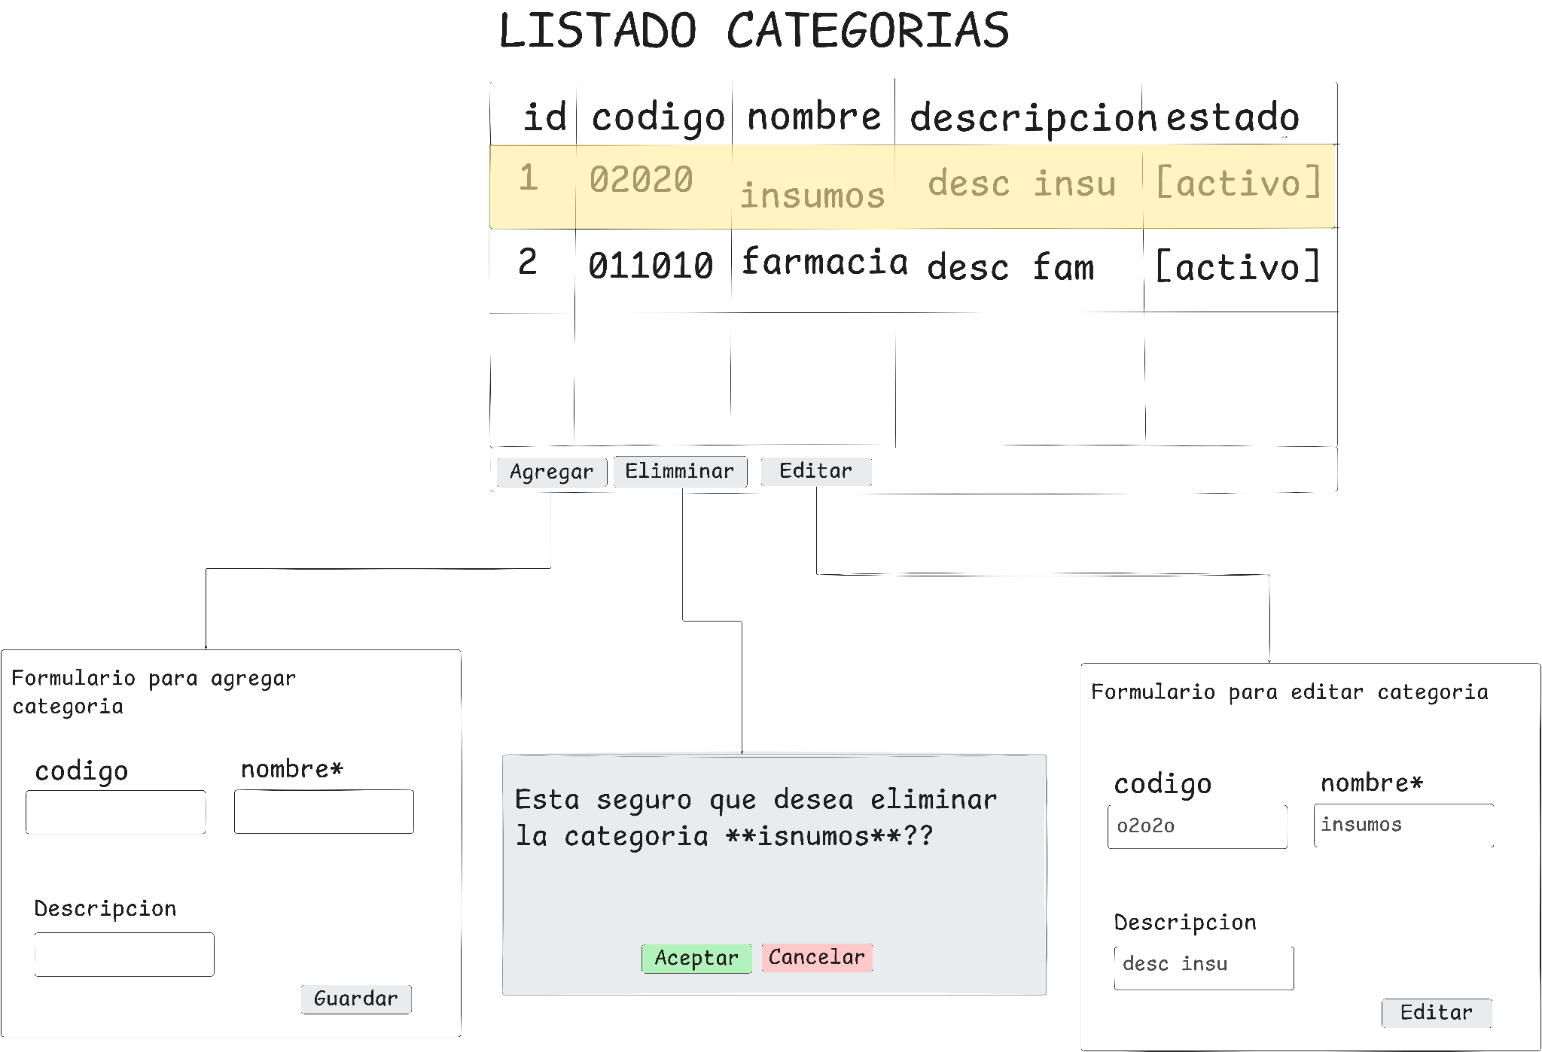
Diego Mauricio Delgado
Notes:
good job!!!

Slide 4
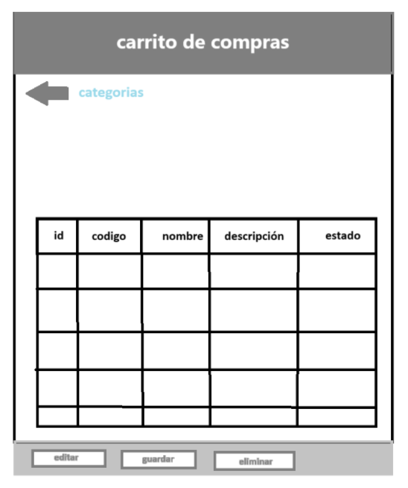
Juan Sebastian Sanchez Silva
Notes:
bad job

Slide 5
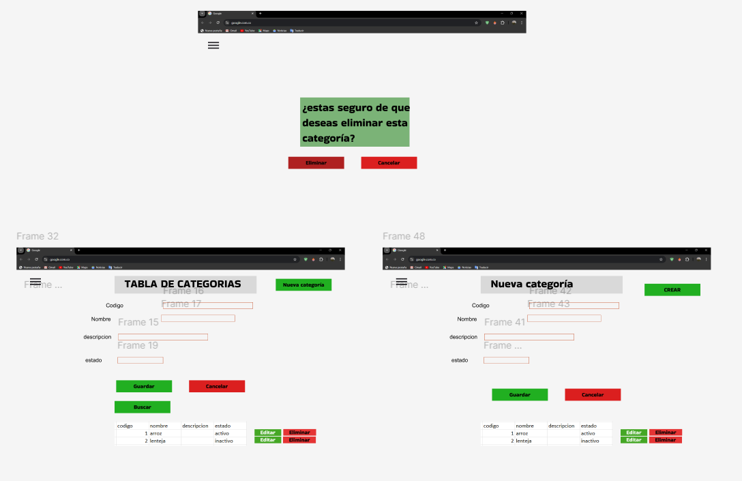
Jordan Ramirez Gallego

Slide 6
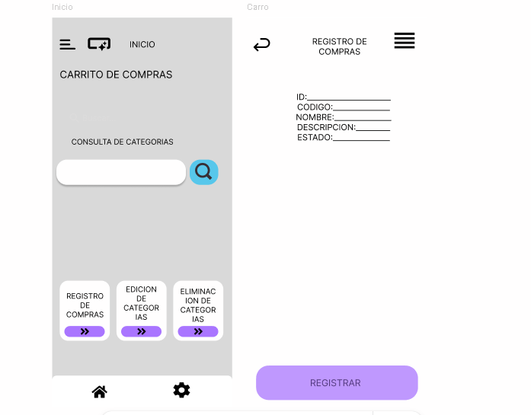
Daniel Felipe Cerquera Idrobo https://www.figma.com/design/AXumRPkCXhDl77HCnHNtWM/CARRITO-DE-COMPRAS?node-id=0-1&t=TZwcvwU19JEa99Qt-1

Slide 7
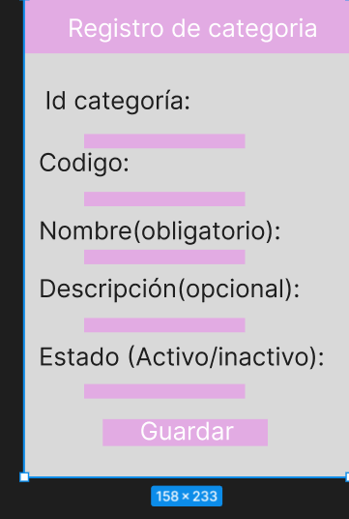
Monica Alexandra Diaz Tovar

Slide 8
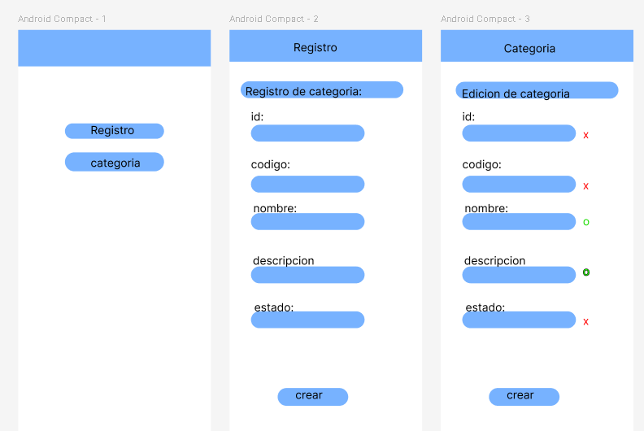
Luis Eduardo Gasca Bonilla

Slide 9
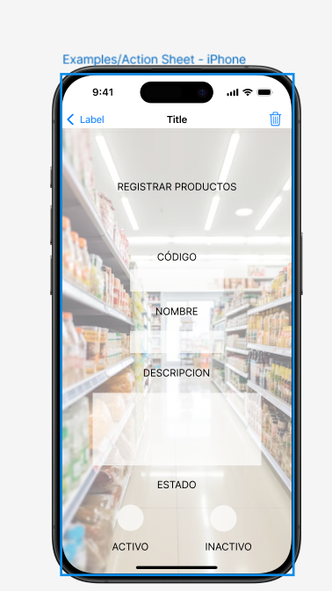
Sergio Andres Ordoñez Díaz
https://www.figma.com/proto/Qg6zyEpXDPVUEkh98hkDVG/Untitled?node-id=0-1&t=13bXAhCTNtO4Hkfa-1

Slide 10
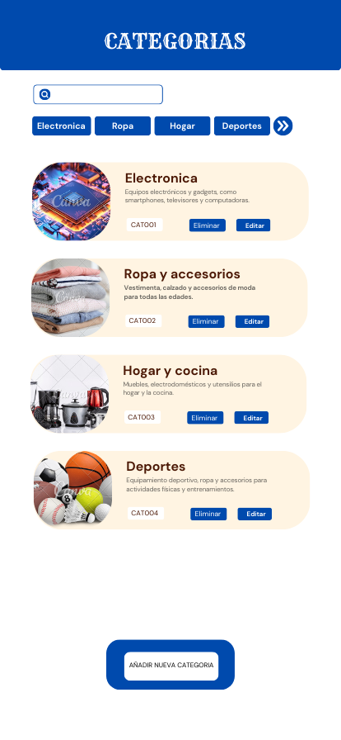
Juan Camilo Medina Perdomo
https://www.canva.com/design/DAGgEi1GQEY/vhEXHxL0GIfYhzCpXdSfxQ/edit?utm_content=DAGgEi1GQEY&utm_campaign=designshare&utm_medium=link2&utm_source=sharebutton

Slide 11
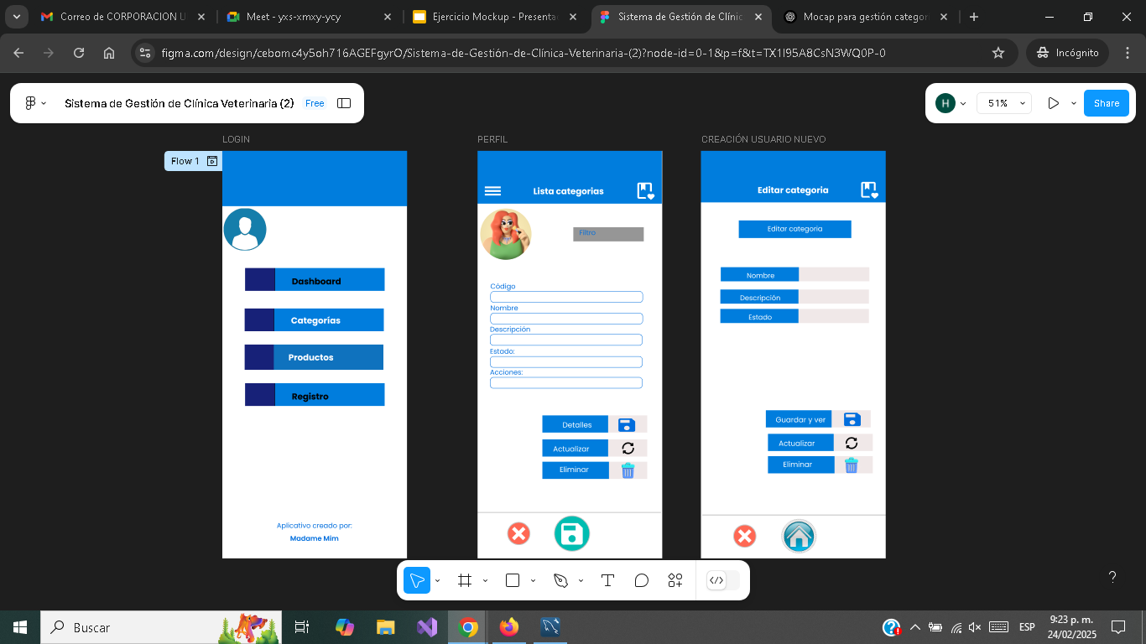
Henderson David Rodriguez Pacheco.

Slide 12
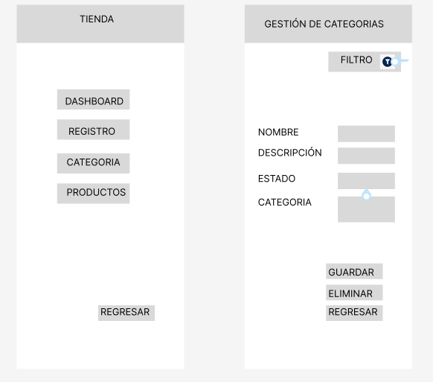
Seam Yong Agudelo

Slide 13
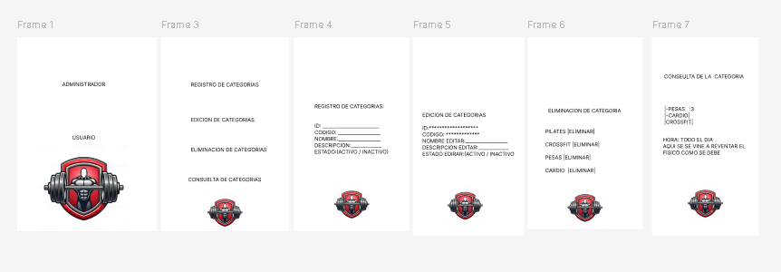
Juan Pablo Borrero Morales
https://www.figma.com/design/LJyd90yfO2LMP6cvqfYG5y/Untitled?node-id=0-1&t=koEe3h7qtVcXnuO1-1

Slide 14
HendersonDavidRodriguezPacheco.

Slide 15
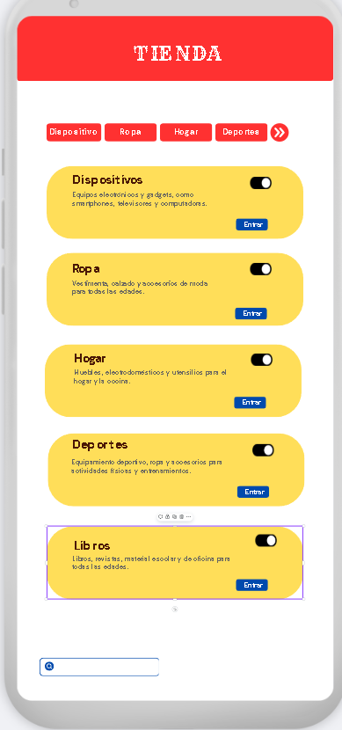
Juan Esteban Alvarez Arciniegas

Slide 16
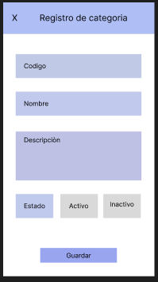
Ana Maria Charry Forero

Slide 17
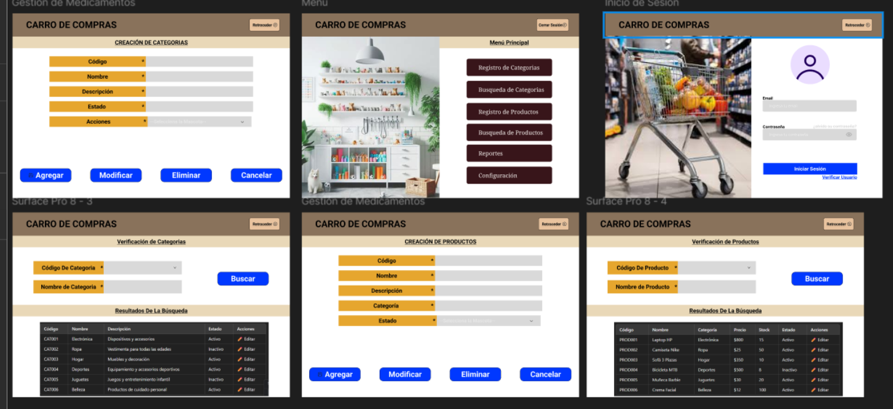
Angel Gustavo Solano Trujillo
https://www.figma.com/design/5pRReohHR1TvnobMeLxALo/EJEMPLO-PROGRAMACION-MOVIL?m=auto&t=WQOomipTx0h5Lj4y-1

Slide 18
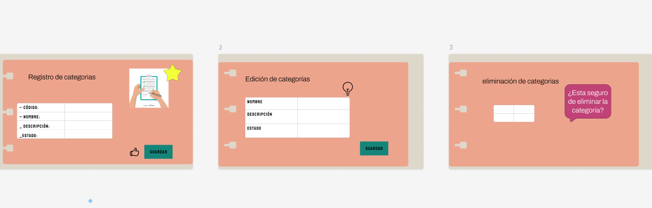
Danna Michelle Morales Losada
https://www.figma.com/slides/h6QEHnc39sUTFYNIluR6hV/Untitled?node-id=0-1&p=f&t=gqVZKaxzfUfhClpF-0

Slide 19
Diego Mauricio Delgado
Notes:
good job!!!

Slide 20
Juan Sebastian Sanchez Silva
Notes:
bad job

Slide 21
Jordan Ramirez Gallego

Slide 22
Daniel Felipe Cerquera Idrobo https://www.figma.com/design/AXumRPkCXhDl77HCnHNtWM/CARRITO-DE-COMPRAS?node-id=0-1&t=TZwcvwU19JEa99Qt-1

Slide 23
Monica Alexandra Diaz Tovar

Slide 24
Luis Eduardo Gasca Bonilla

Slide 25
Sergio Andres Ordoñez Díaz
https://www.figma.com/proto/Qg6zyEpXDPVUEkh98hkDVG/Untitled?node-id=0-1&t=13bXAhCTNtO4Hkfa-1

Slide 26
Juan Camilo Medina Perdomo
https://www.canva.com/design/DAGgEi1GQEY/vhEXHxL0GIfYhzCpXdSfxQ/edit?utm_content=DAGgEi1GQEY&utm_campaign=designshare&utm_medium=link2&utm_source=sharebutton

Slide 27
Henderson David Rodriguez Pacheco.

Slide 28
Seam Yong Agudelo

Slide 29
Juan Pablo Borrero Morales
https://www.figma.com/design/LJyd90yfO2LMP6cvqfYG5y/Untitled?node-id=0-1&t=koEe3h7qtVcXnuO1-1

Slide 30
HendersonDavidRodriguezPacheco.

Slide 31
Juan Esteban Alvarez Arciniegas

Slide 32
Ana Maria Charry Forero

Slide 33
Angel Gustavo Solano Trujillo
https://www.figma.com/design/5pRReohHR1TvnobMeLxALo/EJEMPLO-PROGRAMACION-MOVIL?m=auto&t=WQOomipTx0h5Lj4y-1

Slide 34
Danna Michelle Morales Losada
https://www.figma.com/slides/h6QEHnc39sUTFYNIluR6hV/Untitled?node-id=0-1&p=f&t=gqVZKaxzfUfhClpF-0

